Slide 1
MAMMALIAN PHYSIOLOGICAL RESPONSES TO GRAVITATIONAL FIELDS
GROUP 33

Slide 2
OUTLINE
What are gravitational fields
What are mammalian physiological responses
Effects of gravitational fields on mammals and their responses
Significance of mammalian physiological responses to gravitational fields
Conclusion

Slide 3
INTRODUCTION: GRAVITATIONAL FIELDS
Gravitational fields are the invisible areas around an object where its gravity affects other objects within the field.
They are the forces responsible for the attraction of two bodies toward each other.
Gravitational fields are also responsible for the motion of planets, moons, and other celestial bodies.
The impact of a gravitational field depends on the mass of the object creating it and the distance from that object.

Slide 4
INTRODUCTION: PHYSIOLOGICAL RESPONSES
Physiological responses are the changes in the body’s normal function in response to a stimulus.
These responses are usually automatic and are triggered by factors such as stress, exercise, or changes in the environment.
Responses may include changes in heart rate, blood pressure, and hormone levels among several others.
Mammals, being terrestrial animals, have adapted to the constant influence of gravity on their bodies.

Slide 5
MAMMALS AND GRAVITATIONAL FIELDS.
Mammals being terrestrial animals, have evolved to adapt to the constant influence of gravity on their bodies.
Some systems involved in the mammalian response to gravity include
Musculoskeletal system
Circulatory system
Respiratory system
Vestibular system
Reproductive system

Slide 6
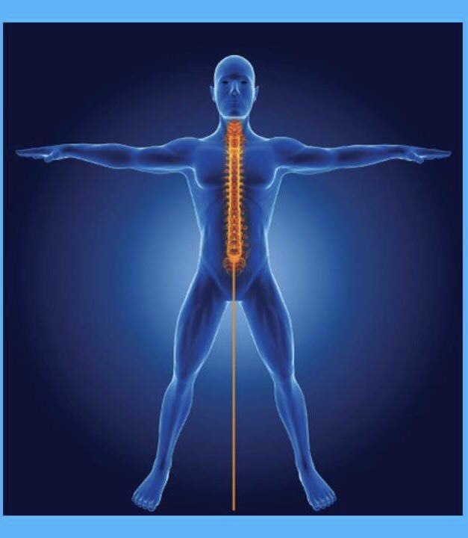
MUSCULOSKELETAL SYSTEM
Mammals have developed specific skeletal and muscular structures to support their bodies against gravity.
The spine also plays a crucial role in maintaining an upright posture while the limbs help in locomotion and movement.
Another impact of gravity on the musculoskeletal system is variation in bone density and strength. Bone density loss may happen due to microgravity.

Slide 7
CIRCULATORY SYSTEM
Gravity influences blood circulation in mammals by causing blood to pool into the lower extremities when standing up which can reduce blood flow to the heart and brain.
In response to this, mammals have strong hearts to pump against the force of gravity and constrict the blood vessels in order to send blood to the vital organs.

Slide 8
RESPIRATORY SYSTEM
Gravity influences blood circulation in mammals by changing the lung function.
Blood flow to the lower extremities causes reduced blood flow to the lungs which decreases oxygen uptake.
In response to this, the mammalian body increases breathing rate to increase oxygen uptake and remove carbon dioxide.

Slide 9
VESTIBULAR SYSTEM
The vestibular system is responsible for detecting changes in head position and movement, and it works in conjunction with other sensory systems, such as vision and proprioception, to help the body maintain balance.
Gravity provides a constant downward force that helps the vestibular system detect changes in head position and movement.
Organisms compensate for the effects of gravity on the vestibular system by widening their stance to maintain balance or adjust their head position to help the system detect changes in the environment.

Slide 10
REPRODUCTIVE SYSTEM
Gravity can influence mammalian reproduction but with minimal impact.
Microgravity can have negative impacts on processes like embryo development and fetal positioning.
It is important to state that the effects of gravity on the reproductive system are not well understood.

Slide 11
CONCLUSION
Mammalian physiological responses to gravitational fields vary depending on the strength and direction of the gravitational force.
It's important to note that these responses can vary among different mammalian species, and long-term exposure to altered gravitational conditions, such as in space, can induce more profound and complex physiological changes.

Slide 12
REFERENCES
NASA - National Aeronautics and Space Administration. (https://www.nasa.gov/)
The Journal of Gravitational Physiology. ( http://www.gravityjournal.org/)
International Journal of Molecular Sciences - Special Issue on Gravitational Biology. https://www.mdpi.com/journal/ijms/special_issues/gravitational_biology
Journal of Applied Physiology. https://journals.physiology.org/journal/jappl
Annual Review of Physiology. https://www.annualreviews.org/journal/physiol
Frontiers in Physiology - Section: Comparative Physiology. https://www.frontiersin.org/journals/physiology/sections/comparative-physiology
Herscheid, J. F. W., & Baisch, V. A. F. (2010). Gravitational Biology II: Biological Effects of and Responses to Gravity (Advances in Space Biology and Medicine).
Haber, H. (1961). Gravitational Physiology.

